Slide 1
Operations on Relations
Lecture 5
Discrete Mathematical Structures

Slide 2
At the Last Class …
Part I: Relations and Digraphs
  Product sets and partitions
  Binary relations and their digraphic form
  Paths in relations
  Representing relations
Part II: Equivalence Relation
  Properties of relations
  Equivalence relations and equivalence classes
  Equivalence relations and partitions

Slide 3
Operations on Relations
Part I: Basic Operations on Relations
  Set operations on relations
  Inverse
  Composition
  Closure of Relation
Part II: Computer Representation and Warshall’s Algorithm
  Representation of Relations in Computer
  Transitive closure and Warshall’s Algorithm

Slide 4
Operations on Relations: (1)
Relations are sets, so, all the operations on sets are applicable for relations.
  Examples on the set of natural numbers:
    “<” ∪ “=” = “≤”
    “≤” ∩ “≥” = “=”
    “<” ∩ “>” = φ

Slide 5
Operations on Relations (2)
Inverse
  R⁻¹ = {(y,x)| (x,y)∈R}
    Note: if R is a relation from A to B, R⁻¹ is a valid relation from B to A.
  (R⁻¹ )⁻¹ = R
    Proof: (R⁻¹ )⁻¹={(x,y)|(y,x)∈R⁻¹}={(x,y)|(x,y) ∈R}
  (R₁∪R₂)⁻¹ = R₁⁻¹∪R₂⁻¹
    Proof:
    (x,y)∈(R₁∪R₂)⁻¹ ⇔ (y,x)∈R₁∪R₂
    ⇔ (y,x)∈R₁ or (y,x) ∈R₂ ⇔ (x,y)∈R₁⁻¹ or (x,y)∈R₂⁻¹
    ⇔ (x,y)∈ R₁⁻¹∪R₂⁻¹

Slide 6
Operations on Relations (3)
Composition
  Rule:
  If R₁⊆A×B, R₂⊆B×C, (A,B,C are sets)
  then: the composition of R₁ and R₂, written as R₂°R₁ is a relation from A to C, and
  R₂°R₁={(x,z)|x∈A, z∈C, and there exists some y∈B，such that (x,y)∈R₁, (y,z)∈R₂}

Slide 7
Composition of Relation
(x,z)∈R₂°R₁ if and only if x∈A, z∈C, and there exists some t∈B，such that (x,t)∈R₁, (t,z)∈R₂
R₂°R₁
x
t
z
R₁
R₂

Slide 8
Composition: Examples
Let A={a,b,c,d}, R₁, R₂ are relations on A：
  R₁ = {(a,a),(a,b),(b,d)}
  R₂ = {(a,d),(b,c),(b,d),(c,b)}
  then:
  R₂°R₁ = {(a,d),(a,c)}
  R₁°R₂ = {(c,d)}
  R₁°R₁= {(a,a),(a,b),(a,d)}
  (R₁°R₁)°R₁ = {(a,a), (a,b), (a,d)}

Slide 9
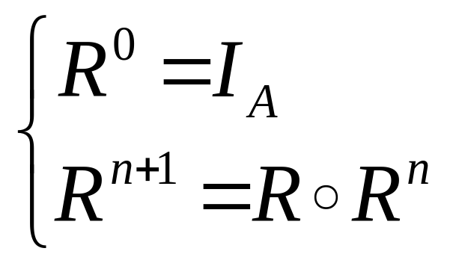
Power of Composition
R^{n} corresponds the relation defined by the path of length n in Digraph of R.

Slide 10
Properties of Relation Composition(1)
Associative Law
(R₃°R₂) °R₁ = R₃°(R₂°R₁)
(where, R₁⊆A×B, R₂⊆B×C, R₃⊆C×D)
  Proof
  (x,y)∈(R₃°R₂) °R₁ ⇔ x∈A, y∈D, and there exists s∈B, such that xR₁s and s(R₃°R₂)y ⇔ there exist t∈C, such that xR₁s, sR₂t, tR₃y ⇔ x(R₂°R₁)t, tR₃y ⇔ (x,y)∈R₃°(R₂°R₁)

Slide 11
Properties of Relation Composition(2)
Inverse of composition
  (R₂°R₁)⁻¹ = R₁⁻¹ °R₂⁻¹ (where R₁⊆A×B, R₂⊆B×C)
  Proof
  (x,y)∈(R₂°R₁)⁻¹ ⇔ (y,x)∈R₂°R₁ ⇔ there exists some t∈B, such that yR₁t and tR₂x ⇔ xR₂⁻¹t and tR₁⁻¹y ⇔ (x,y)∈R₁⁻¹ °R₂⁻¹

Slide 12
Properties of Relation Composition(3)
Distribution Law
  (G∪H)°F = G°F∪H°F
  (where F⊆A×B, and H, G⊆B×C)
  (G∩H)°F⊆G°F ∩H°F
    Why the equality doesn’t hold?
    A wrong proof: G°F∩H°F ⊆(G∩H)°F
      if (x,y)∈G°F∩H°F , then (x,y)∈G°F, (x,y)∈H°F. So, there exists some t, such that (x,t) ∈F, and (t,y)∈G, (t,y)∈H. So, (t,y)∈G∩H, it follows that (x,y)∈(G∩H)°F

Slide 13
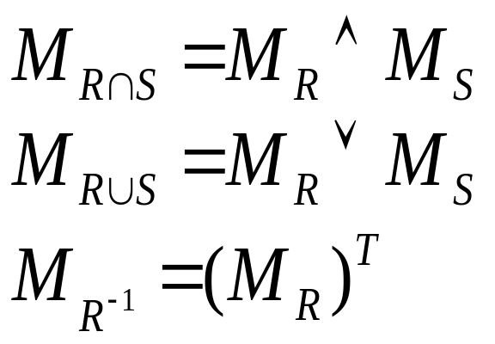
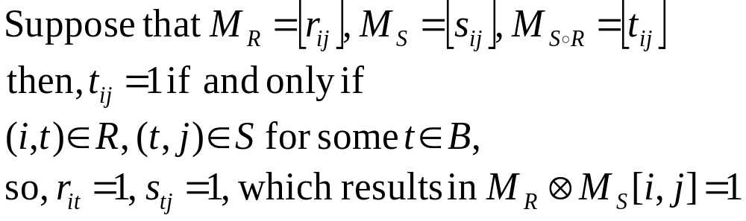
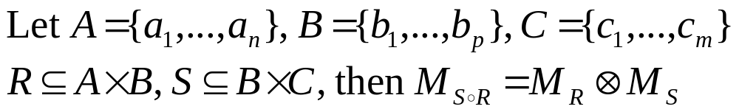
Operations and Relation Matrix

Slide 14

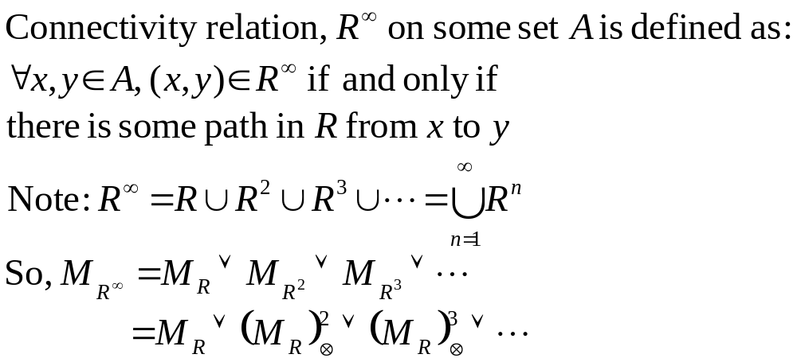
Connectivity Relation

Slide 15
Inverse Keeping Properties of Relation
Reflexivity: ∀x, (x,x)∈R₁ ⇔ (x,x)∈ R₁⁻¹
Irreflexivity: ∀x, (x,x)∉ R₁ ⇔ (x,x)∉ R₁⁻¹
Symmetry: ∀x,y, if (x,y)∈ R₁⁻¹, then (y,x)∈ R₁, since R₁ is symmetric，(x,y)∈ R₁, ∴(y,x)∈ R₁⁻¹
Antisymmetry: ∀x,y, if (x,y)∈R₁⁻¹, (y,x)∈R₁⁻¹, then (y,x)∈R₁, (x,y)∈R₁, since R₁ is antisymmetric，x=y.
Transitivity: ∀x,y,z, if (x,y)∈R₁⁻¹, (y,z)∈R₁⁻¹,
then (y,x)∈R₁, (z,y)∈R₁, since R₁ is transitive，(z,x)∈ R₁, ∴(x,z)∈R₁⁻¹

Slide 16
Composition Keeping Properties of Relation
Reflexivity: ∀x, ∵(x,x)∈R₁ and (x,x)∈R₂, ∴(x,x)∈ R₂°R₁
Irreflexivity: counterexample: R₁={(a,b)}, R₂={(b,a)}, then R₂°R₁={(a,a)}
Symmetry: counterexample: R₁={(c,b),(b,c)}, R₂={(c,d), (d,c)}, then R₂°R₁={(b,d)}
Antisymmetry: counterexample: R₁={(a,b)}, R₂,={(b,a)}, then R₂°R₁={(a,a)}
Transitivity: counterexample: R₁={(x,t),(y,s)}, R₂={(t,y), (s,z)}, then R₂°R₁={(x,y),(y,z)}

Slide 17
Summary of Keeping Properties
 | reflexivity | irreflexivity | symmetry | anti-symmetry | transitivity
R₁⁻¹ |  |  |  |  | 
R₁∩R₂ |  |  |  |  | 
R₁∪R₂ |  |  |  |  | 
R₁°R₂ |  |  |  |  | 

Slide 18

Closure – the Idea
The orange circle：
１．circle（property）
２．Contain the object
３．If there is a green circle which satisfies above 1,2, then it must contain the orange circle.
The purple square：
１．square（property）
２．Contain the object
３．Any square contain the object contain the purple square as well
an object

Slide 19
Closure: the Generic Definition
Let R be a relation on A, P is some property, R₁ is called P closure if:
  R₁ has property P is
  R⊆ R₁
  If there is some relation R’ on A has property P and includes R as well, then R₁⊆R’

Slide 20
Reflexive Closure
Reflexive closure of R is R∪I_{A}
  For any x∈A, (x,x)∈I_{A}, so, (x,x)∈R∪I_{A}
  R⊆R∪I_{A}
  Let R’ is a reflexive relation on A, and R⊆R’, then, for any (x,y)∈R∪I_{A}, (x,y)∈R, or (x,y)∈I_{A}. In both cases, (x,y)∈R’, so, R∪I_{A}⊆R’

Slide 21
Symmetric Closure
Symmetric closure of R is R∪R⁻¹
  For any x,y∈A, if (x,y)∈R∪R⁻¹, then (x,y)∈R or (x,y)∈R⁻¹, it follows that (y,x)∈R⁻¹, or (y,x)∈R, then (y,x)∈R∪R⁻¹
  R⊆R∪R⁻¹
  Let R’ is a symmetric relation on A, and R⊆R’, then, for any (x,y)∈R∪R⁻¹, (x,y)∈R, or (x,y)∈R⁻¹.
    Case 1: (x,y)∈R, then (x,y)∈R’
    Case 2: (x,y)∈R⁻¹, then (y,x)∈R, then (y,x)∈R’. Since R’ is symmetric, (x,y)∈R’
  So, R∪R⁻¹⊆R’

Slide 22
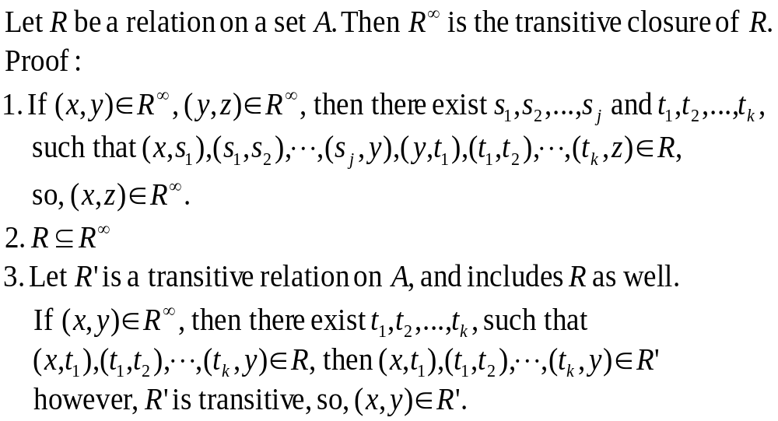
Transitive Closure

Slide 23

Linked List and Its Implementation
D₄
1
D₄
4
start
head
D₁
2
D₁
3
D₂
3
D₂
5
D₅
4
D₅
0
D₃
5
D₃
1
Data
Pointer
Implemented by arrays

Slide 24

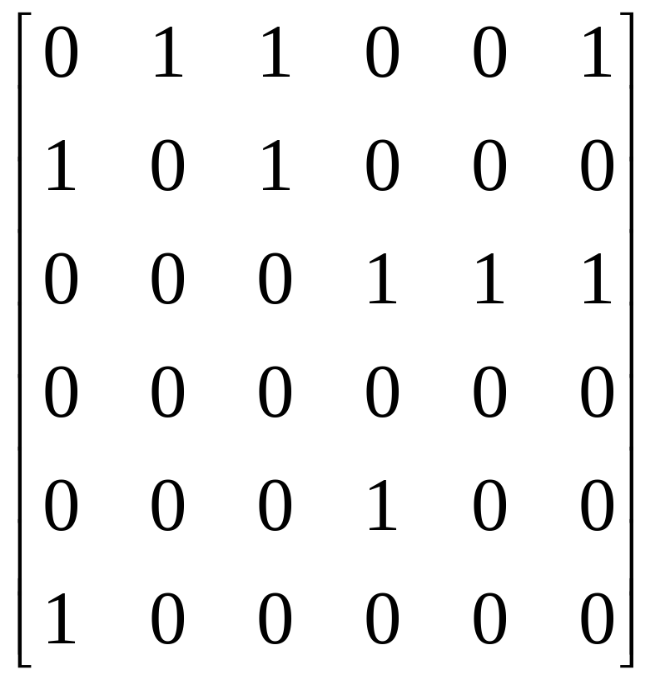
Representing a Digraph as a Matrix
2
5
2
1
8
3
7
1
4
3
6
4
5
10
9
6
A relation with 10 ordered pairs
Matrix as a 2-dimensional array A[ ][ ]

Slide 25
Representing a Digraph as a Linked List
2
1
2
2
3
5
3
3
6
1
1
3
3
1
5
4
4
6
1
6
2
9
10
4
8
1
3
0
7
6
5
2
5
start
2
1
8
3
7
1
4
3
6
4
5
10
9
6
A relation with 10 ordered pairs
tail
head
next

Slide 26
Indexed by Vertices
10
2
4
0
5
8
1
2
2
3
5
3
3
6
1
1
2
3
1
5
4
4
6
1
6
3
0
3
0
6
0
7
0
0
1
9
2
5
2
1
8
3
7
1
4
3
6
4
5
10
9
6
A relation with 10 ordered pairs
vert
tail
head
next

Slide 27
Adding a New Edge: a Comparison
Adding a pair (i, j) to a relation R
Using matrix:
Simply: MAX[i,j]←1
Using linked list:
P←P+1
TAIL[P]←I
HEAD[P]←J
NEXT[P]←VERT[I]
VERT[I]←P
Insert the new item in front of the list of vertex i

Slide 28

Checking Transitivity Using Matrix
Determine whether a relation with p ordered pairs is transitive or not
RESULT←T
FOR I=1 THRU N
FOR J=1 THRU N
IF (MAT[I,J]=1) THEN
FOR K=1 THRU N
IF (MAT[J,K]=1 and MAT[I,K]=0) THEN
RESULT=F
N² different MAT[I,J], among which P are “1”
Execute P times at most
So, the total steps executed T_{A}=PN+(N²-P).
Let P=kN², then T_{A}=kN³+(1-k)N².

Slide 29
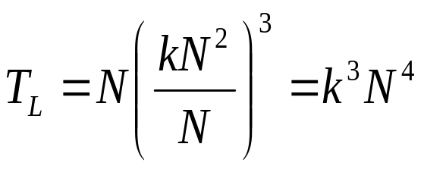
Transitivity Using Linked List
Determine whether a relation with p ordered pairs is transitive or not
RESULT←T
FOR I=1 THRU N
X←VERT[I]
WHILE (X≠0)
J←HEAD[X]
Y←VERT[J]
WHILE (Y≠0)
K←HEAD[Y]
TEST←EDGE[I,K]
IF (TEST) THEN Y←NEXT[Y]
ELSE RESULT←F
Y←NEXT[Y]
X←NEXT[X]
Averagely, P/N=D edges begin at a vertex, so, the function EDGE takes about D steps.
The total steps executed is ND³ averagely. As before, we assume that P=KN² (0≤k≤1), so:
N
D
D

Slide 30
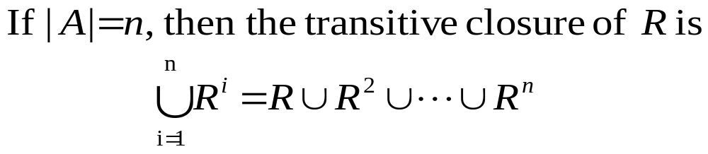
Transitive Closure on Finite Set
Since the total of elements in A is n, if there is a path of length m from x to y, and m>n-1, then all the nodes on the path cannot be distinct. The segment between two identical nodes can be deleted, which means that: if xR∞y, then for some k, 1≤k≤n, such that xR^{n}y.

Slide 31
Warshall’s Algorithm
ALGORITHM MARSHALL
1. CLOSURE ← MAT
2. FOR K=1 THRU N
a. FOR I=1 THRU N
1. FOR J=1 THRU N
a. CLOSURE[I,J] ← CLOSURE[I,J] ∨ (CLOSURE[I,K]∧CLOSURE[K,J])
END OF ALGORITHM WARSHALL
K is the intermediate vertex between I , J.

Slide 32
Highest-numbered intermediate vertex
The highest intermediate vertex in the intervals (s_{i}s_{k}), (s_{k}s_{j}) are both less than s_{k}
s_{j}
s_{k}
s_{i}
A specific order is assumed for all vertices
Vertical position of vertices reflect their vertex numbers

Slide 33
Correctness of Washall’s Algorithm
Notation:
  The value of r_{ij} changes during the execution of the body of the “for k…” loop
    After initializations: r_{ij}⁽⁰⁾
    After the kth time of execution: r_{ij}^{(k)}

Slide 34
Correctness of Washall’s Algorithm
If there is a simple path from s_{i} to s_{j}(i≠j) for which the highest-numbered intermediate vertex is s_{k}, then r_{ij}^{(k)}=true.
Proof by induction:
  Base case: r_{ij}⁽⁰⁾=true if and only if s_{i}s_{j}∈E
  Hypothesis: the conclusion holds for h<k(h≥0)
  Induction: the simple s_{i}s_{j}-path can be looked as s_{i}s_{k}-path+s_{k}s_{j}-path, with the indices h₁, h₂ of the highest-numbered intermediate vertices of both segment strictly(simple path) less than k. So, r_{ij}^{(h1)}=true, r_{ij}^{(h2)}=true, then r_{ij}^{(k-1)}=true, r_{ij}^{(k-1)}=true(Remember, false to true can not be reversed). So, r_{ij}^{(k)}=true

Slide 35
Correctness of Washall’s Algorithm
If there is no path from s_{i} to s_{j}, then r_{ij}=false.
Proof
  If r_{ij}=true, then only two cases:
  r_{ij} is set by initialization, then s_{i}s_{j}∈E
  Otherwise, r_{ij} is set during the kth execution of (for k…) when r_{ij}^{(k-1)}=true, r_{ij}^{(k-1)}=true, which, recursively, leads to the conclusion of the existence of a s_{i}s_{j}-path. (Note: If a s_{i}s_{j}-path exists, there exists a simple s_{i}s_{j}-path)

Slide 36
Home Assignments
To be checked
  Ex 4.6: 2,3,4,6,8,12
  Ex 4.7: 7, 8, 12, 14, 19, 20, 23-24, 26-28, 30-31, 36-37
  Ex 4.8: 8,10,12,14,18, 20, 23-25

